Slide 1

HumanAid
Team Cod!ngCheetas
Team Members: Ayush Saxena
Priyadarshini Patel

Slide 2

HumanAid
we care for your safety

Slide 3
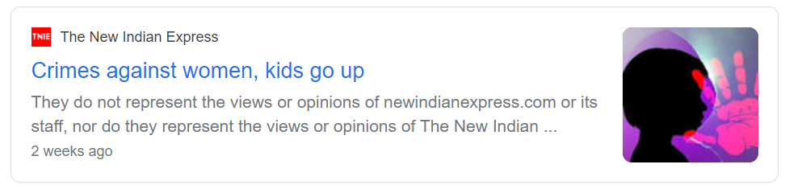

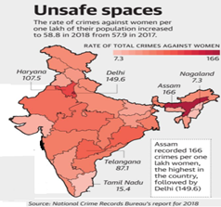
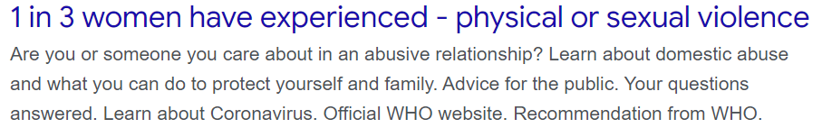
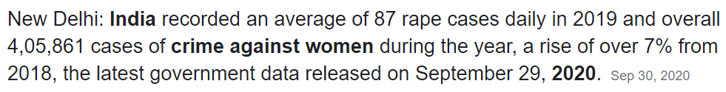
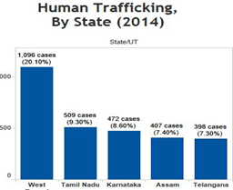
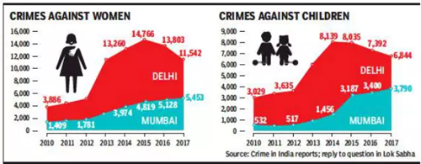
Motivation

Slide 4
RELATED WORK

Slide 5


Slide 6
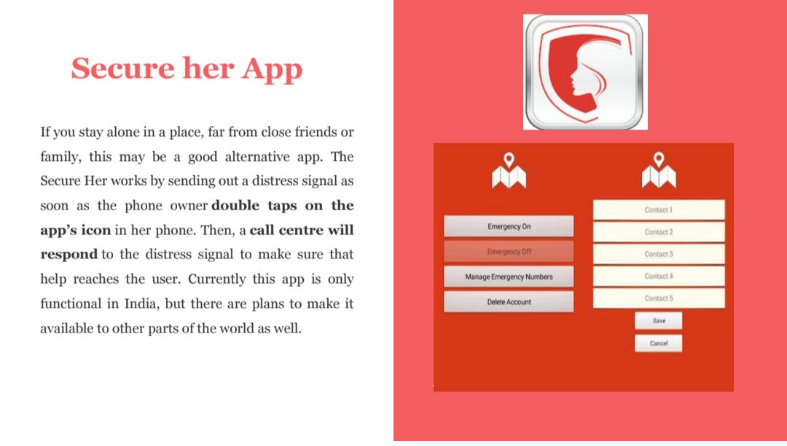

Slide 7
HumanAid
we care your safety

Slide 8
HumanAid : we care your safety
Personal safety and timely help is absolute necessity. We strongly believe that timely help in right time may help many needy ones and can decrease this crime rate a bit.
Our App HumanAid will help people to tackle such emergency situations and will ensure women. We believe that our app will contribute in decreasing this rate of crimes and ensure safety to women.
Our idea is to build an app that ensures safety to everyone especially women by providing timely help in emergency situation. The idea is to build a user-friendly and robust application that can help individuals by sending emergency alert messages along with current location and also that can be triggered with minimal efforts. Along with these additional features are listed below.

Slide 9
Features :
Login/Register: The user first register by entering all the necessary information including mobile number,name and Email , after registering user can log-in via the HumanAid App.
User Profile Management: The user can edit his/her personal information like email, mobile number anytime.
Add Emergency Contacts: The user can add his/her preferred contacts with the customized message or select the default message.
Fake Siren: In case of an emergency situation, the user will press the button that will produce the loud sound to seek the attention of the nearby people
Trigger : In case of an emergency situation,if the women cannot able to operator her mobile than she can Press the volume button which will lead to trigger SMS to the emergency contacts.
Guardian Shield: This feature will define the probable visiting area radius exiting, which will lead to trigger the SMS to the emergency contacts.
Duration: This feature will define the probable duration of visit, exceeding which will lead to trigger the SMS to the emergency contacts.

Slide 10

WIREFRAMES SCREENSHOTS
WELCOME PAGE

Slide 11
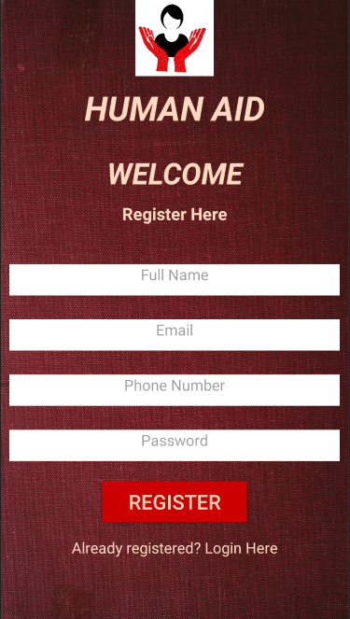
WIREFRAMES SCREENSHOTS
REGISTRATION PAGE

Slide 12
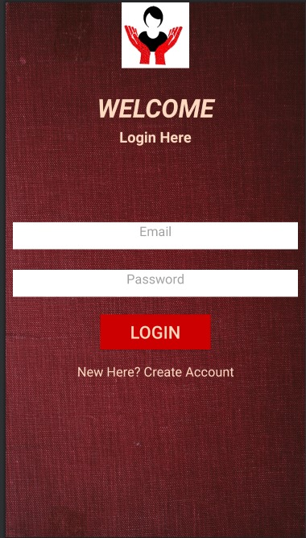
WIREFRAMES SCREENSHOTS
LOGIN PAGE

Slide 13
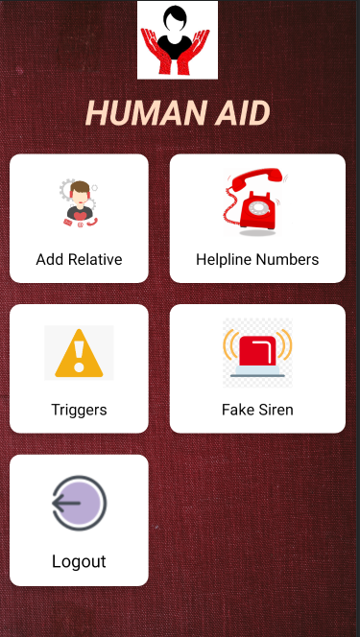
WIREFRAMES SCREENSHOTS
HOME PAGE

Slide 14
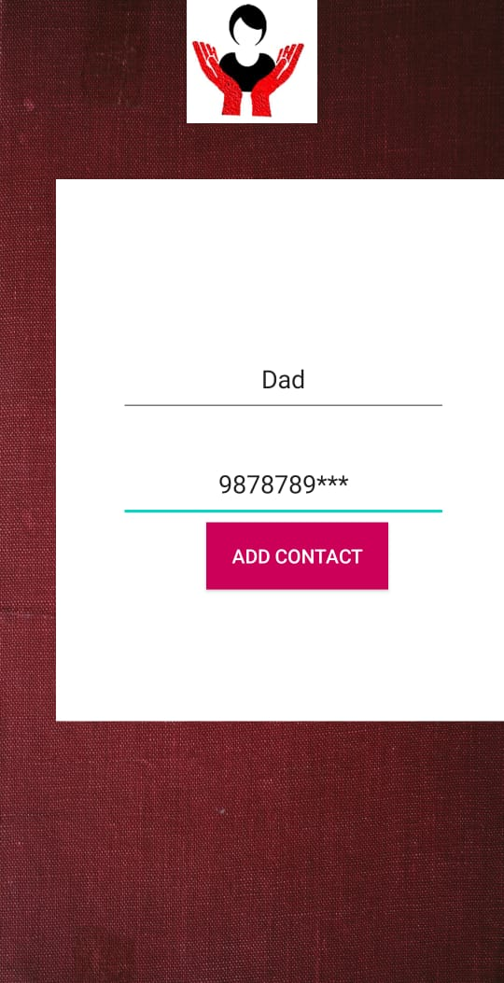
WIREFRAMES SCREENSHOTS
ADD RELATIVE PAGE

Slide 15
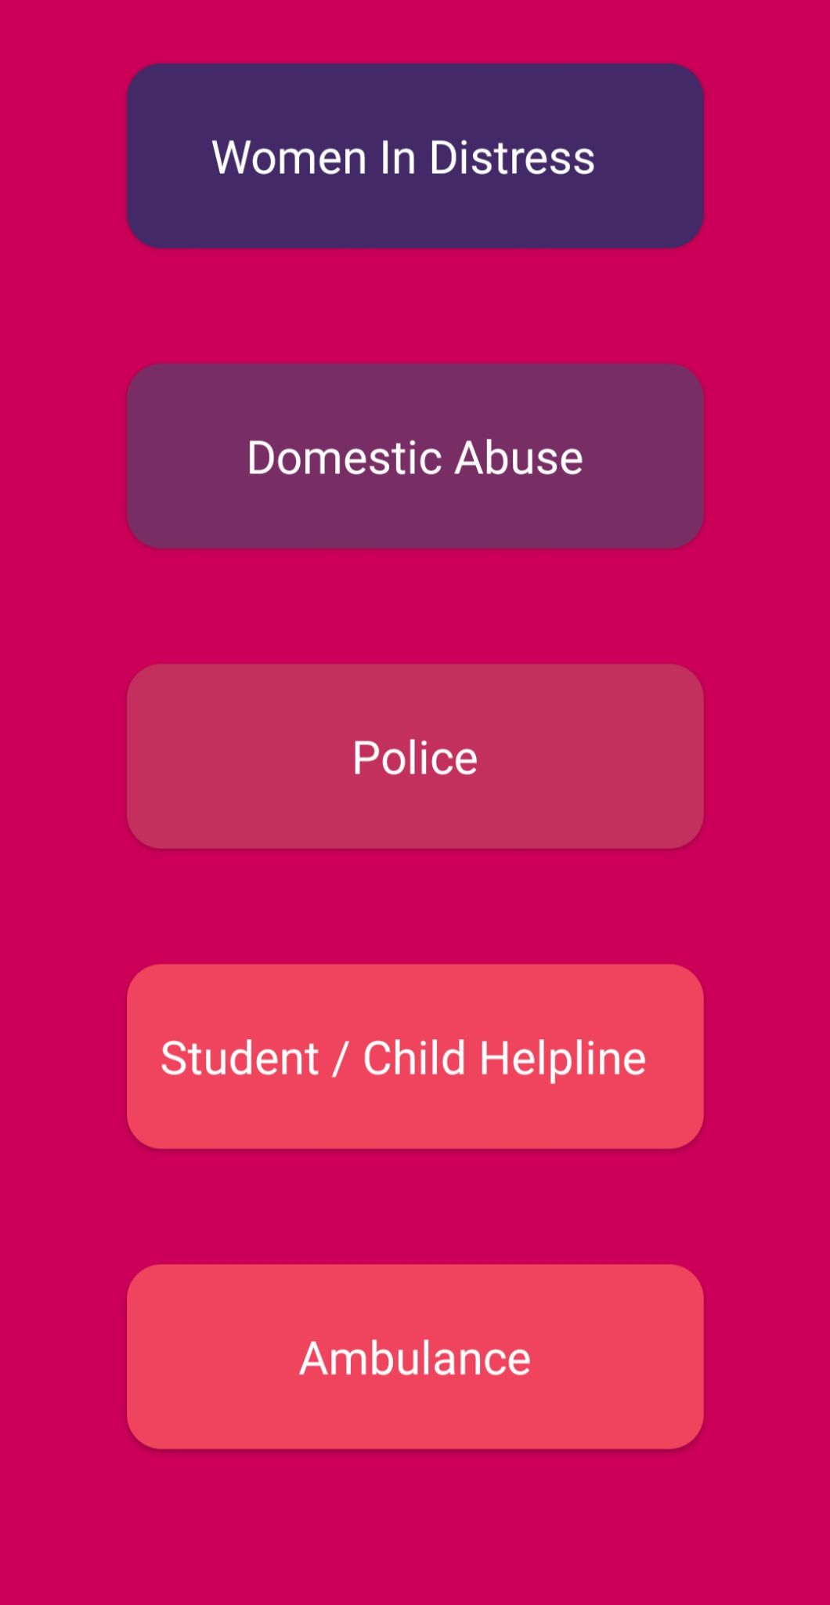
WIREFRAMES SCREENSHOTS
HELPLINE NUMBER

Slide 16
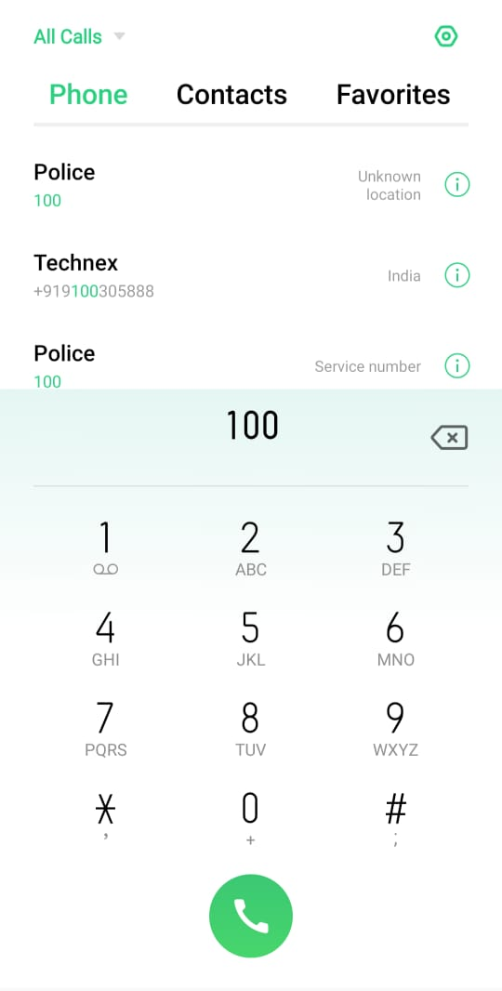
WIREFRAMES SCREENSHOTS
POLICE

Slide 17
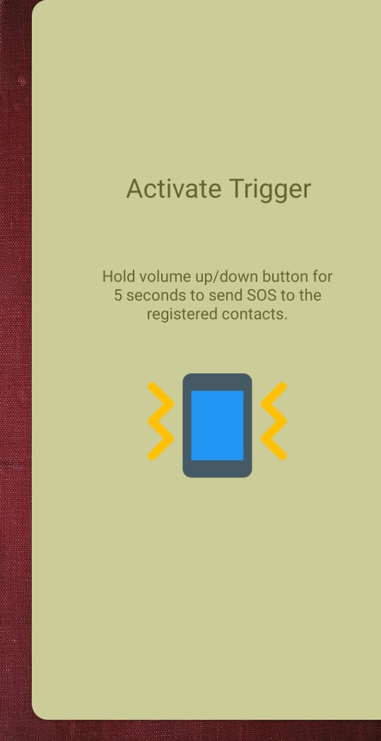
WIREFRAMES SCREENSHOTS
TRIGGERS

Slide 18
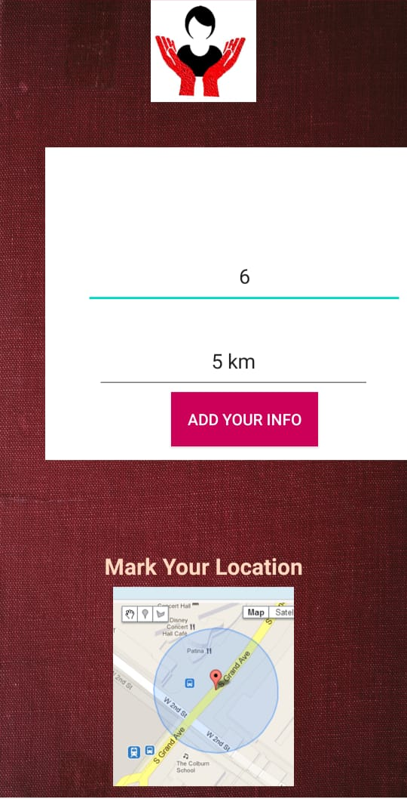
WIREFRAMES SCREENSHOTS
LOCATION ALERT/
SET DURATION

Slide 19
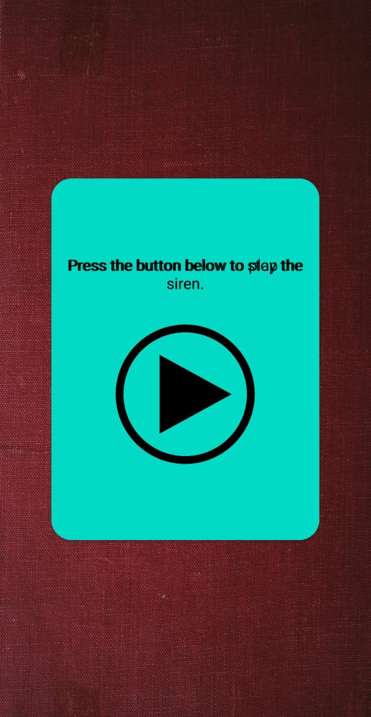
WIREFRAMES SCREENSHOTS
FAKE SIREN

Slide 20




Tools and Technologies used :-
Android Studio
JAVA
Github

Slide 21
DEMO OF HUMANAID :

Slide 22


Slide 23
Thank You!

